Slide 1


Slide 2
Web Programming
Integration Techniques by Henrik Lange Bendixen

Slide 3
Agenda
Common Web standards
Web Protocols:
  OSI model
  TCP Handshake
  HTTP protocol
Data formats
  JSON
  XML
  HTML
Integration Protocols
  REST
  SOAP
  MQTT
  Scraping
Integration Strategies
Real-time Communication
  Websockets
  Polling, Long-polling and No-polling
  Deltas
Event-driven architectures
  Events
  Publish/Subscribe Patterns
Data Management in Web Services
  Pull on load
  Caching
  Logging
Data Strategies
  Relational Data
  Data Lakes

Slide 4
Goal of todays lecture
Create and execute a proper strategy for real-time data collaboration, including communication protocols, event driven architectures, data management and data strategies.

Slide 5
Web Protocols

Slide 6
IP
IP is the address protocol
  IPv4 is the most commonly used protocol today
    IPv4 uses 32-bit addresses (2³²)
    Defined by 4 sets of 3 digits, divided by dots
    Ports are supplied after a colon
    Path is defined after a slash
      123.321.12.3:80/folder
    The subnet mask defines the local networking range
    127.0.0.0 is usually your localhost
    192.168 and 10.0 addresses are usually used for LAN
  IPv6 is the latest version of the protocol
    Uses 128-bit addresses (2¹²⁸)
    Defined by 8 sets of 4 hex digits, where 0000 can be omitted
      12fa:32ff: : : :0291: : 9de1

Slide 7
TCP
Handles connection handshakes
Handles data packages

Slide 8

HTTP
Contents:
Verb
Resource
Version
Headers
Status
Body
Request:
GET /address/ HTTP/1.1
Accept: text/html
Response:
HTTP/1.1 200 OK
Content-type: text-html
<!DOCTYPE html>
<html lang=“en”>
…

Slide 9
HTTP Verbs
GET
    Retrieve data (from server to client)
    Should have no side effects
    Parameters in resource (URI)
POST
    Send data (from client to server)
    Parameters in body
PUT
    Replace data (sent from client to server)
DELETE
    Removes data
GET, PUT & DELETE are idempotent

Slide 10
HTTP Verbs
HEAD
  Same as GET, but transfers status and header only
CONNECT
  Establishes a tunnel identified by URI
OPTIONS
  Describes communication options for target
TRACE
  Performs a message loop-back test along the path to the target
  Let’s try CMD tracert

Slide 11
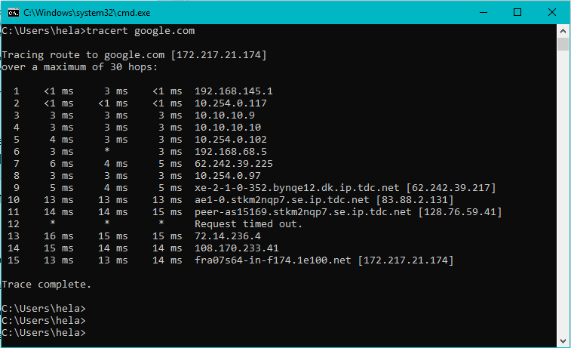
Trace

Slide 12
HTTP Resource
Regular
  gp?product=1234&comment=4321
    url?key1=value1&key2=value2&key3=value3
RESTful
  gp/product/1234/comment/4321

Slide 13
HTTP Version
Different versions have different behavior:
1991: HTTP 0.9
    Single line protocol with no headers.
    Only GET supported: GET index.html
1996: HTTP 1.0
    Added headers, and a version string
1999: HTTP 1.1
    Connection keep-alive by default
    Additional caching mechanisms
    Primary HTTP version used today
2015: HTTP 2.0
    Binary framing
    Header compression
    General optimizations

Slide 14
HTTP Headers
Request specific format:
Request secondary format if first is not available
Request preferred encoding
Request preferred language
User-Agent (usually set by browser)
Accept: text/html
Accept: application/json,application/xml
Accept-Encoding: bzip2,gzip
Accept-Language: dk, es, en-US
User-Agent: Mozilla/5.0 (Windows NT 10.0; Win64; x64) AppleWebKit/537.36 (KHTML, like Gecko) Chrome/71.0.3578.98 Safari/537.36

Slide 15
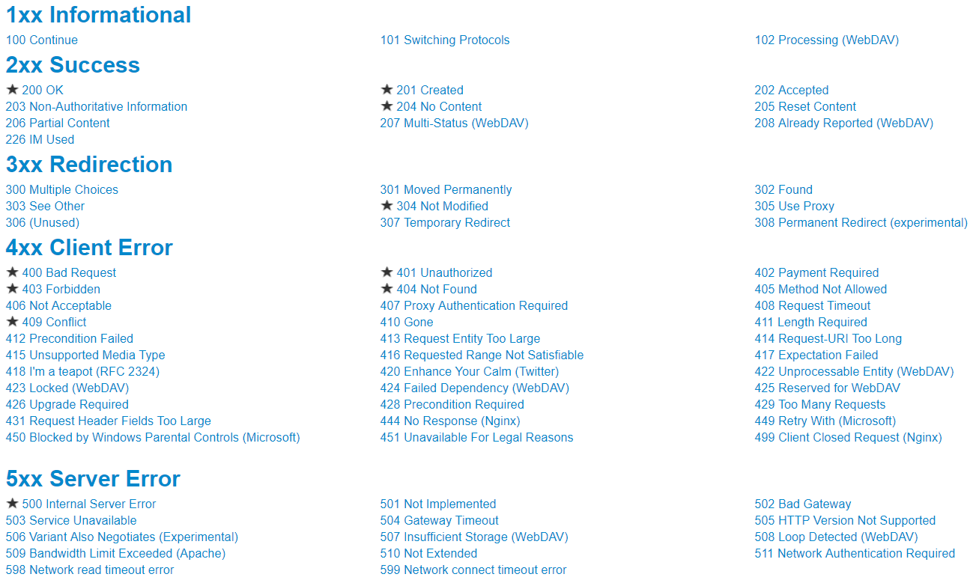
HTTP Status Codes
Source: https://www.restapitutorial.com/httpstatuscodes.html

Slide 16
HTTP Request Body
PUT & POST request typically have a body. HTML forms usually results in a POST request with a x-www-form-urlencoded type
POST /post HTTP/1.1
Host: url.org
User-Agent: Mozilla/5.0 (Windows NT 10.0; Win64; x64) AppleWebKit/537.36 (KHTML, like Gecko) Chrome/71.0.3578.98 Safari/537.36
Accept: */*
Content-Length: 18
Content-Type: application/x-www-form-urlencoded
user=bo&comment=Hi

Slide 17
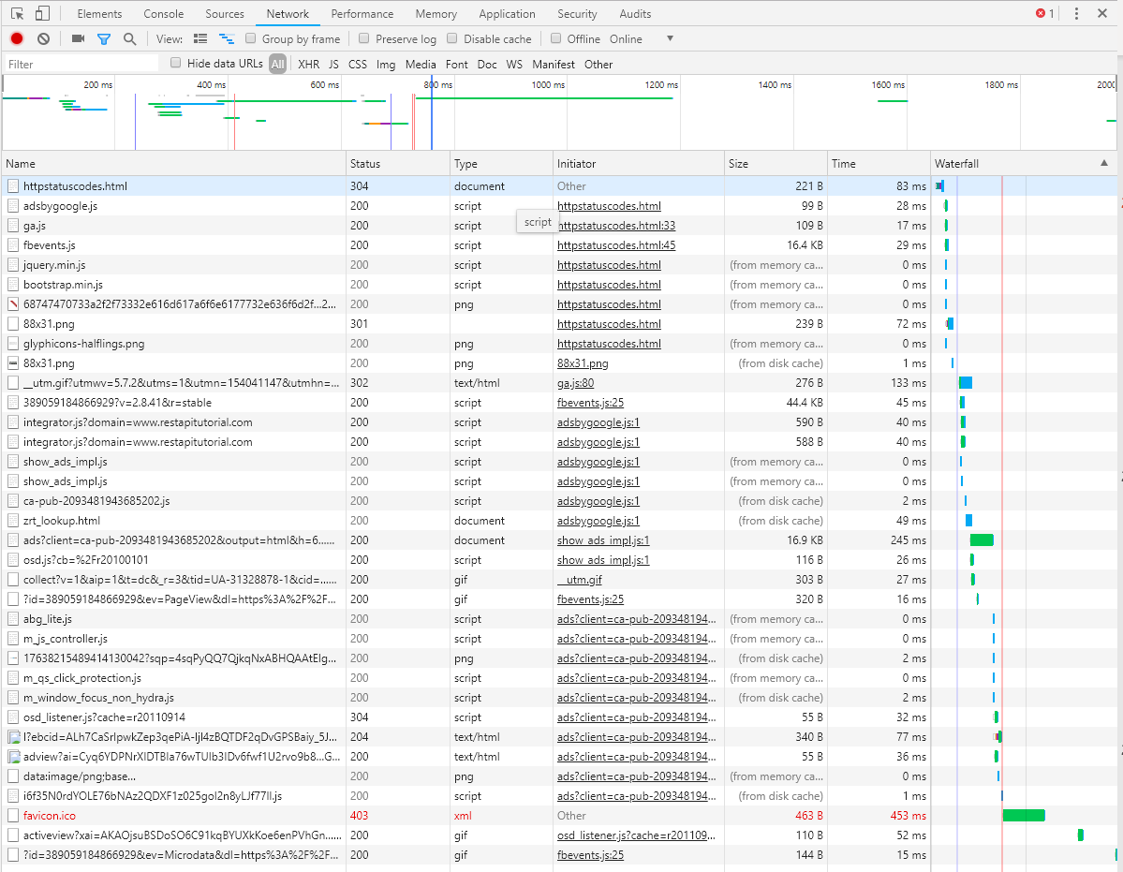
HTTP in action
Let’s try Chromes “network” tab

Slide 18
HTTP vs HTTPS
HyperText Transfer Protocol Secure:
Means trusted SSL certificate is in place
    Anyone can get one
    TLS is an updated version, but we still call it SSL
    Stands for Secure Socket Layer, Transport Layer Security
Requests and responses are scrambled and encrypted
    Stored data is not
Uses port 443 instead of port 80
Increases SEO ranking
Browsers warn users not to use HTTP
    https://www.guru99.com/difference-http-vs-https.html

Slide 19
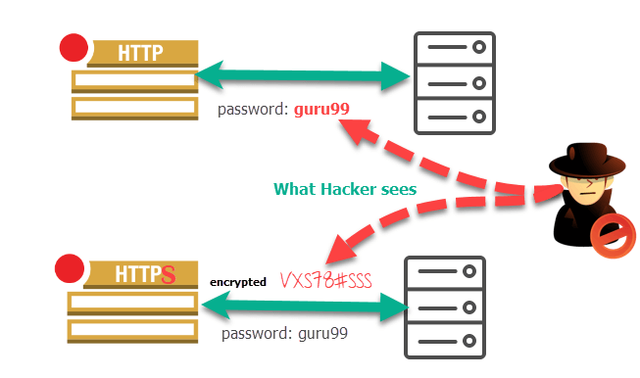

HTTP vs HTTPS
Source: https://www.guru99.com/difference-http-vs-https.html

Slide 20
Other Protocols
FTP
  File transfer protocol
  Default way of working with files on the server
SMTP
  Simple Mail Transfer Protocol
  Default way of sending and receiving e-mails

Slide 21
The URL
http://www.fuzzball.nu/Project/simplevote/index.html
HTTP protocol
World-wide-web (indicates website)
Domain name
Top-level domain
Mapping on server
Specific file
  If this address is a file path, the index.html file will be loaded automatically if it exists
  This can easily be disabled

Slide 22
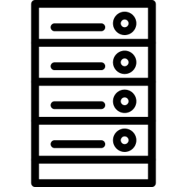

Sessions & Cookies
Sessions are stored on the server
  invisible to the user
    Reliable
Cookies are stores on the client and thus
  Visible and editable by
    User
    Every other website
    Commonly used by spyware
Sessions expire when the browser is closed
Session timeouts can be set
Session ID’s are stored in cookies
SESSION
Response
Request
COOKIE

Slide 23
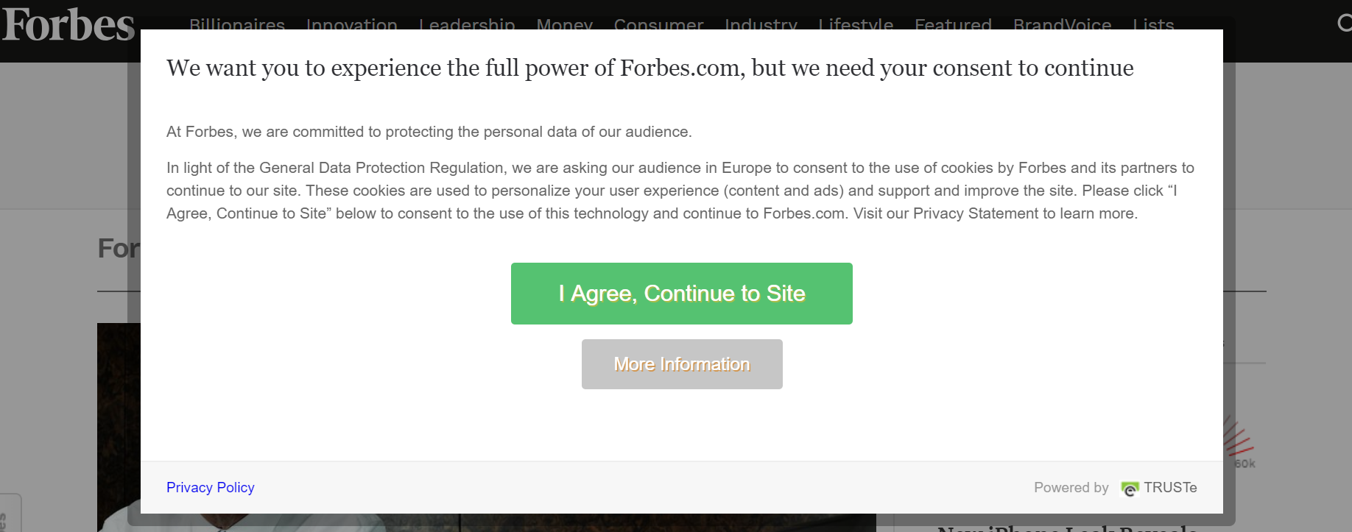
Sessions & Cookies
Sites must warn you about Cookies
Why?
Why not Sessions?

Slide 24
Data Formats

Slide 25
Client-Server Relationships:
Web communication
Most networked applications follow a client-server architecture, where a client application communicates with a server application to access network services. The communication between the client and server is typically done through a request/response model.
Client: The application that requests a service from a server.
Server: The application that provides a service to clients.
Request: A message sent by the client to the server to request a service.
Response: A message sent by the server to the client in response to a request.
When you browse a website, your web browser acts as the client and sends an HTTP request to the web server, which acts as the server. The server then responds with an HTTP response, containing the data necessary to display the requested web page in the browser.
Peer-to-peer (P2P) architecture is an alternative to client-server architecture, where applications communicate directly with each other without relying on a central server.

Slide 26
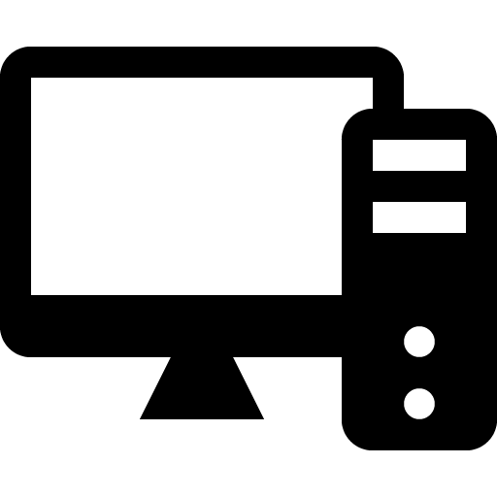

Client Server Relationship
Request
Request
Response
Response
Response
Request

Slide 27
Client Server Relationship
Servers can communicate directly with each other
Clients can communicate directly with each other
The most common setup is where clients only communicate with the server

Slide 28
Client Server Relationship
All online devices have an IP address per online network driver
Multiple servers on a single IP address are reached through ports
  Port forwarding
  Multiple servers on one device
URL’s are IP address shortcuts
  DNS (Domain Name Server)
Let’s try our local network settings

Slide 29
Press Enter
Address is put into browser
Application >> LAN already explained
LAN is connected by router
  Router connected to ISP (internet service provider)
  ISP has DNS (domain name server)
  DNS translates domain name to IP address
  Browser saves IP for further communication
  Routers throughout the world communicate to find the requested IP address
  Server responds to request

Slide 30
The OSI Model: The Seven Layers of Networking
The OSI model is a conceptual model that defines the communication functions of a telecommunication or computing system. It divides the communication process into seven layers and helps to understand how different networking devices work together.
Physical layer: Handles the physical connection between devices.
Data link layer: Ensures reliable data transmission over a network.
Network layer: Routes data packets between devices on different networks.
Transport layer: Manages the reliable transmission of data between applications.
Session layer: Establishes and manages sessions between applications.
Presentation layer: Handles data formatting and encryption.
Application layer: Provides services to applications for network communication.
When you browse a website, your computer sends a request to the server using the HTTP protocol. This request goes through all seven layers of the OSI model before reaching the server and getting a response.

Slide 31
OSI Model
Layer
Example
Alternative
Application
Browser
App
Application Layer
HTTP
HTTPS
Transport layer
TCP
UDP
Network layer
IP
IP
Link layer
Ethernet Driver
WiFi Driver
Hardware layer
Ethernet
WiFi chip

Slide 32
The TCP/IP Model: The Four Layers of Networking
The TCP/IP model is a simpler and more practical model than the OSI model. It consists of four layers and is the foundation of the internet.
Network Access Layer: Deals with physical connections and media types.
Internet Layer: Handles addressing and routing of packets across networks.
Transport Layer: Provides reliable data transmission between applications.
Application Layer: Provides network services to applications.
When you visit a website, your browser sends a request to the server using the HTTP protocol. This request goes through the four layers of the TCP/IP model before reaching the server and getting a response.

Slide 33
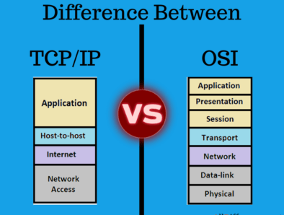
TCP/IP vs OSI Model
TCP/IP is more commonly used today than the OSI model

Slide 34
The Network Layer & IP:
Data Routing Cross-Network
The network layer is responsible for routing data packets between networks. IP (Internet Protocol) is the primary protocol used at this layer.
IP addresses: Unique identifiers assigned to devices on a network.
Routing: The process of sending data packets to their intended destinations.
ICMP (Internet Control Message Protocol): Used for error reporting and network diagnostics.
When you send an email to someone on a different network, your email client sends the message to your local router. The router uses the destination IP address to route the message through the internet to the recipient's network, where it's delivered to their email server.
There are several alternative routing protocols, such as OSPF and BGP, used by large enterprise networks.

Slide 35
The Transport Layer and TCP:
Ensuring Reliable Data Transmission
The transport layer is responsible for managing the reliable transmission of data between applications. TCP (Transmission Control Protocol) is the primary protocol used at this layer.
Three-way handshake: The process of establishing a reliable connection between two devices.
Flow control: Regulating the amount of data sent by a sender to avoid overwhelming a receiver.
Error detection and correction: Ensuring data is transmitted without errors.
When you download a large file from a server, your browser uses TCP to ensure the file is transmitted without errors. TCP breaks the file into smaller chunks, and each chunk is sent with a sequence number. The receiver sends an acknowledgment message back to the sender for each chunk received, and the sender resends any chunks that were not acknowledged. This process continues until all the chunks are received and assembled into the complete file.
UDP (User Datagram Protocol) is an alternative to TCP that provides faster transmission but does not ensure reliability.

Slide 36
The Application Layer and HTTP:
Providing Network Services to Applications
The application layer provides network services to applications, such as file transfer, email, and web browsing. HTTP (Hypertext Transfer Protocol) is the primary protocol used for web browsing.
Client-server architecture: Applications communicate with servers to access network services.
Request-response model: Applications send requests to servers, which respond with data.
URL (Uniform Resource Locator): A standard way to identify resources on the web.
When you visit a website, your browser uses HTTP to communicate with the web server. The browser sends an HTTP request to the server, which responds with HTML, CSS, and JavaScript files that are used to display the web page. The browser then sends additional requests for images, videos, and other resources needed to fully render the page.
There are several alternative application layer protocols, such as FTP (File Transfer Protocol) and SMTP (Simple Mail Transfer Protocol), used for file transfer and email communication, respectively.

Slide 37
Integration Protocols

Slide 38
JSON: A Lightweight Data-Interchange Format
JSON (JavaScript Object Notation) is a lightweight data-interchange format that is easy for humans to read and write, and easy for machines to parse and generate. It is commonly used in web applications to transmit data between the client and server.
A web application that uses AJAX (Asynchronous JavaScript and XML) to retrieve data from a server may receive the data in JSON format.
Syntax: JSON uses key-value pairs to represent data, separated by commas and enclosed in curly braces {}.
Data types: JSON supports several data types, including strings, numbers, arrays, and objects.
{
"name": "John",
"age": 30,
"city": "New York"
}

Slide 39
XML: Extensible Markup Language
XML (Extensible Markup Language) is a markup language that is used to encode documents in a format that is both human-readable and machine-readable. It is commonly used in web applications for data exchange and document formatting.
<bookstore>
<book category="Children">
<title>Harry Potter</title>
<author>J.K. Rowling</author>
<year>2005</year>
<price>29.99</price>
</book>
<book category="Web">
<title>Learning XML</title>
<author>Erik T. Ray</author>
<year>2003</year>
<price>39.95</price>
</book>
</bookstore>
A web application that uses SOAP (Simple Object Access Protocol) to communicate with a web service may use XML to encode the request and response messages.
Syntax: XML uses tags to define elements and attributes to provide additional information about elements.
Data types: XML supports several data types, including strings, numbers, and Boolean values.

Slide 40
Advanced XML Concepts:
Attributes and Namespaces
XML supports advanced concepts, such as attributes and namespaces, to provide additional information about elements and improve the organization and clarity of XML documents.
A web application that uses XML to describe data may use attributes and namespaces to provide additional information and improve the organization and clarity of the XML document.
Attributes: Attributes provide additional information about elements in XML documents. They are defined using the syntax attribute="value" and can be used to describe the format of the data in an element or provide metadata about the element.
Namespaces: Namespaces allow multiple XML vocabularies to coexist in the same XML document without conflicting element names. They are defined using a URI (Uniform Resource Identifier) and a prefix, such as xmlns:prefix="URI".
<catalog xmlns:book="http://example.com/book">
<book:book id="bk001" language="en">
<book:title>The Adventures of Tom Sawyer</book:title>
<book:author>Mark Twain</book:author>
<book:year>1876</book:year>
</book:book>
<book:book id="bk002" language="fr">
<book:title>Les Misérables</book:title>
<book:author>Victor Hugo</book:author>
<book:year>1862</book:year>
</book:book>
</catalog>

Slide 41
SOAP with XML: Exchanging Structured Information Between Applications
SOAP (Simple Object Access Protocol) is a protocol for exchanging structured information between applications over HTTP or other transport protocols. It uses XML for message formatting and is commonly used in enterprise applications for complex data exchange.
XML: SOAP uses XML for message formatting, allowing complex data structures and metadata to be exchanged between applications.
WSDL (Web Services Description Language): WSDL is an XML-based language for describing web services and the operations they offer.
<soap:Envelope xmlns:soap="http://www.w3.org/2003/05/soap-envelope" xmlns:wsdl="http://www.example.com/wsdl">
<soap:Header/>
<soap:Body>
<wsdl:GetStockPrice>
<wsdl:StockName>IBM</wsdl:StockName>
</wsdl:GetStockPrice>
</soap:Body>
</soap:Envelope>

Slide 42
Consuming a SOAP API in Node.js:
Using the soap Package
Node.js provides a powerful platform for building web applications that consume SOAP APIs. The soap package is a popular package for making SOAP requests to SOAP APIs.
soap Package: The soap package is a popular package for making SOAP requests to SOAP APIs. It provides an easy-to-use API for making SOAP requests to a SOAP API.
Example in Action: A web application that consumes a SOAP API to retrieve or update data may use the soap package in Node.js to make SOAP requests to the SOAP API.
Alternatives: Other popular packages for making SOAP requests in Node.js include strong-soap, node-soap, and easy-soap-request.
const soap = require('soap');
const url = 'http://www.dneonline.com/calculator.asmx?wsdl';
const args = { intA: 2, intB: 3 };
soap.createClient(url, function(err, client) {
client.Add(args, function(err, result) {
console.log(result);
});
});

Slide 43
Consuming a SOAP API in Java:
Using the javax.xml.soap Package
Java provides a robust platform for building enterprise applications that consume SOAP APIs. The javax.xml.soap package is a built-in package for making SOAP requests to SOAP APIs.
javax.xml.soap Package: The javax.xml.soap package is a built-in package for making SOAP requests to SOAP APIs. It provides an easy-to-use API for making SOAP requests to a SOAP API.
Example in Action: An enterprise application that consumes a SOAP API to exchange complex data structures, such as financial statements and trading data, may use the javax.xml.soap package in Java to make SOAP requests to the SOAP API.
Alternatives: Other popular libraries for making SOAP requests in Java include Apache CXF, Spring WS, and JAX-WS.

Slide 44
Consuming a SOAP API in Java:
Using the javax.xml.soap Package
import javax.xml.soap.*;
public class SOAPClient {
public static void main(String[] args) throws Exception {
SOAPConnectionFactory soapConnectionFactory = SOAPConnectionFactory.newInstance();
SOAPConnection soapConnection = soapConnectionFactory.createConnection();
String url = "http://www.dneonline.com/calculator.asmx";
SOAPMessage soapRequest = createSOAPRequest();
SOAPMessage soapResponse = soapConnection.call(soapRequest, url);
printSOAPResponse(soapResponse);
soapConnection.close();
}
private static SOAPMessage createSOAPRequest() throws Exception {
MessageFactory messageFactory = MessageFactory.newInstance();
SOAPMessage soapMessage = messageFactory.createMessage();
SOAPPart soapPart = soapMessage.getSOAPPart();
String soapEnvelope = "<soapenv:Envelope xmlns:soapenv=\"http://schemas.xmlsoap.org/soap/envelope/\" xmlns:tem=\"http://tempuri.org/\">\n" +
" <soapenv:Header/>\n" +
" <soapenv:Body>\n" +
" <tem:Add>\n" +
" <tem:intA>2</tem:intA>\n" +
" <tem:intB>3</tem:intB>\n" +
" </tem:Add>\n" +
" </soapenv:Body>\n" +
"</soapenv:Envelope>";
soapPart.setContent(new StreamSource(new StringReader(soapEnvelope)));
soapMessage.saveChanges();
return soapMessage;
}
private static void printSOAPResponse(SOAPMessage soapResponse) throws Exception {
TransformerFactory transformerFactory = TransformerFactory.newInstance();
Transformer transformer = transformerFactory.newTransformer();
Source sourceContent = soapResponse.getSOAPPart().getContent();
StreamResult result = new StreamResult(System.out);
transformer.transform(sourceContent, result);
}
}
Java provides a robust platform for building enterprise applications that consume SOAP APIs. The javax.xml.soap package is a built-in package for making SOAP requests to SOAP APIs.
javax.xml.soap Package: The javax.xml.soap package is a built-in package for making SOAP requests to SOAP APIs. It provides an easy-to-use API for making SOAP requests to a SOAP API.
Example in Action: An enterprise application that consumes a SOAP API to exchange complex data structures, such as financial statements and trading data, may use the javax.xml.soap package in Java to make SOAP requests to the SOAP API.
Alternatives: Other popular libraries for making SOAP requests in Java include Apache CXF, Spring WS, and JAX-WS.

Slide 45
REST with JSON: Accessing and Manipulating Resources Over HTTP
REST (Representational State Transfer) is an architectural style for building web services that use HTTP methods to access and manipulate resources. It uses JSON for message formatting and is commonly used in web applications for simple data exchange.
JSON: REST uses JSON for message formatting, allowing simple data structures to be exchanged between applications.
HTTP methods: RESTful APIs use HTTP methods, such as GET, POST, PUT, and DELETE, to access and manipulate resources.
{
"id": "1",
"name": "John Doe",
"email": "johndoe@example.com"
}

Slide 46
Accessing a REST API in Node.js:
Using the Request Module
Node.js provides a powerful platform for building web applications that consume RESTful APIs. The request module is a popular module for making HTTP requests to RESTful APIs.
Request Module: The request module is a popular module for making HTTP requests to RESTful APIs. It provides an easy-to-use API for making GET, POST, PUT, and DELETE requests to a RESTful API.
Example in Action: A web application that accesses a RESTful API to retrieve or update data may use the request module in Node.js to make HTTP requests to the API.
Alternatives: Other popular modules for making HTTP requests in Node.js include Axios, SuperAgent, and Node-fetch.
const request = require('request');
request('https://jsonplaceholder.typicode.com/posts/1', { json: true }, (err, res, body) => {
if (err) { return console.log(err); }
console.log(body);
});

Slide 47
Providing a RESTful API in Node.js:
Using Express.js
const express = require('express');
const app = express();
app.get('/', (req, res) => {
res.send('Hello World!');
});
app.get('/users/:userId', (req, res) => {
const userId = req.params.userId;
// Retrieve user information from database
res.json({ id: userId, name: 'John Doe' });
});
app.post('/users', (req, res) => {
const newUser = req.body;
// Save new user information to database
res.status(201).json(newUser);
});
app.listen(3000, () => {
console.log('Example app listening on port 3000!');
});
Node.js provides a powerful platform for building web applications that provide a RESTful API. Express.js is a popular framework for building web applications in Node.js that support RESTful APIs.
Express.js: Express.js is a popular framework for building web applications in Node.js that support RESTful APIs. It provides an easy-to-use API for defining routes and handling HTTP requests.
Example in Action: A web application that provides a RESTful API to allow client applications to retrieve or update data may use Express.js in Node.js to define routes and handle HTTP requests.
Alternatives: Other popular frameworks for building web applications in Node.js that support RESTful APIs include Hapi.js, Koa.js, and Nest.js.

Slide 48
Accessing a REST API in Java:
Using the Java.net.HttpURLConnection Class
Java provides a robust platform for building enterprise applications that consume RESTful APIs. The Java.net.HttpURLConnection class is a built-in class for making HTTP requests to RESTful APIs.
Java.net.HttpURLConnection Class: The Java.net.HttpURLConnection class is a built-in class for making HTTP requests to RESTful APIs. It provides an easy-to-use API for making GET, POST, PUT, and DELETE requests to a RESTful API.
Example in Action: An enterprise application that accesses a RESTful API to exchange complex data structures, such as financial statements and trading data, may use the Java.net.HttpURLConnection class to make HTTP requests to the API.
Alternatives: Other popular libraries for making HTTP requests in Java include Apache HttpComponents, OkHttp, and Spring RestTemplate.

Slide 49
Accessing a REST API in Java:
Using the Java.net.HttpURLConnection Class
import java.net.*;
import java.io.*;
public class HttpURLConnectionExample {
public static void main(String[] args) throws Exception {
URL url = new URL("https://jsonplaceholder.typicode.com/posts/1");
HttpURLConnection con = (HttpURLConnection) url.openConnection();
con.setRequestMethod("GET");
con.setConnectTimeout(5000);
con.setReadTimeout(5000);
BufferedReader in = new BufferedReader(
new InputStreamReader(con.getInputStream()));
String inputLine;
StringBuffer content = new StringBuffer();
while ((inputLine = in.readLine()) != null) {
content.append(inputLine);
}
in.close();
System.out.println(content.toString());
}
}

Slide 50
Providing a RESTful API in Java: Using JAX-RS
import javax.ws.rs.*;
import javax.ws.rs.core.*;
@Path("/users")
public class UserResource {
@GET
@Path("/{userId}")
@Produces(MediaType.APPLICATION_JSON)
public Response getUser(@PathParam("userId") int userId) {
// Retrieve user information from database
User user = new User(userId, "John Doe");
return Response.ok(user).build();
}
@POST
@Consumes(MediaType.APPLICATION_JSON)
@Produces(MediaType.APPLICATION_JSON)
public Response addUser(User user) {
// Save new user information to database
return Response
.status(Response.Status.CREATED)
.entity(user)
.build();
}
}
Java provides a robust platform for building enterprise applications that provide a RESTful API. JAX-RS is a popular specification for building RESTful APIs in Java.
JAX-RS: JAX-RS is a popular specification for building RESTful APIs in Java. It provides an easy-to-use API for defining resources and handling HTTP requests.
Example in Action: An enterprise application that provides a RESTful API to exchange complex data structures, such as financial statements and trading data, may use JAX-RS in Java to define resources and handle HTTP requests.
Alternatives: Other popular frameworks and libraries for building RESTful APIs in Java include Spring MVC, Dropwizard, and Jersey.

Slide 51
MQTT with JSON: Real-time Data Exchange for IoT Applications
MQTT (Message Queuing Telemetry Transport) is a protocol for sending messages between devices over a network. It uses JSON for message formatting and is commonly used in IoT (Internet of Things) applications for real-time data exchange.
JSON: MQTT uses JSON for message formatting, allowing devices to exchange lightweight and structured data in real-time.
Publish/Subscribe model: MQTT uses a publish/subscribe model, where devices can subscribe to topics and receive messages published on those topics.
{
"temperature": 23.5,
"humidity": 50.2,
"pressure": 1013.25
}

Slide 52
MQTT, JSON, and XML: Choosing the Right Protocol and Data Format for Your Application
Choosing the right protocol and data format for your application depends on the type of data you need to exchange and the requirements of your application. MQTT, JSON, and XML each have their own strengths and weaknesses.
MQTT: MQTT is ideal for low-bandwidth and unreliable network connections, such as those used in IoT applications. It uses a lightweight protocol and message format, making it efficient for real-time data exchange over low-quality networks.
  Example: A smart home system that controls lights, temperature, and security cameras may use MQTT to exchange real-time data between sensors and actuators over a wireless network.
JSON: JSON is easy to read and write, making it a popular choice for web applications that require simple data exchange. It is also supported by most programming languages and can be easily converted to other formats.
  Example: An e-commerce website that displays product information and reviews may use JSON to exchange data between the server and the client, allowing for fast and efficient data exchange.
XML: XML is a more verbose format but offers powerful features for document validation and schema definition. It is commonly used in enterprise applications, such as finance, construction, and medicine, where accurate data formats are critical.
  Example: A financial application that exchanges complex data structures, such as financial statements and trading data, may use XML to ensure the accuracy and consistency of the data.

Slide 53
Web Scraping: Extracting Data from Websites
Web scraping involves extracting data from websites that do not provide an API or other data access mechanism. Web scraping can be used to extract data from any website, but it should be used with care to avoid legal and ethical issues.
Web Scraping: Web scraping involves extracting data from websites that do not provide an API or other data access mechanism. It can be used to extract any type of data from a website, including text, images, and video.
Tools: There are many tools available for web scraping, including libraries and frameworks for programming languages like Python, Node.js, and Java.
Ethical Considerations: Web scraping should be used with care to avoid legal and ethical issues. It is important to respect the terms of service of the website being scraped and to avoid scraping private or confidential data.

Slide 54
Web Scraping in Node.js:
Using the Cheerio Package
Node.js provides a powerful platform for web scraping. The Cheerio package is a popular package for web scraping in Node.js.
const axios = require('axios');
const cheerio = require('cheerio');
axios.get('https://www.example.com/’)
.then(response => {
const html = response.data;
const $ = cheerio.load(html);
const title = $('title').text();
console.log(title);
})
.catch(error => {
console.log(error);
});
Cheerio Package: The Cheerio package is a popular package for web scraping in Node.js. It provides a jQuery-like API for manipulating HTML and XML documents.
Example in Action: A web application that needs to extract data from a website, such as product information from an e-commerce site, may use the Cheerio package in Node.js to scrape the required data.
Alternatives: Other popular packages for web scraping in Node.js include Puppeteer, Nightmare.js, and JSDOM.

Slide 55
Web Scraping in Java: Using the Jsoup Library
Java provides a robust platform for web scraping. The Jsoup library is a popular library for web scraping in Java.
import org.jsoup.*;
import org.jsoup.nodes.*;
import org.jsoup.select.*;
public class WebScraper {
public static void main(String[] args) {
try {
Document doc =
Jsoup
.connect("https://www.example.com/")
.get();
String title = doc.title();
System.out.println(title);
} catch (Exception e) {
e.printStackTrace();
}
}
}
Jsoup Library: The Jsoup library is a popular library for web scraping in Java. It provides a jQuery-like API for manipulating HTML and XML documents.
Example in Action: A web application that needs to extract data from a website, such as product information from an e-commerce site, may use the Jsoup library in Java to scrape the required data.
Alternatives: Other popular libraries for web scraping in Java include Jaunt, HTMLUnit, and jSoup-XML.

Slide 56
Integration Strategies

Slide 57
Agenda
Common Web standards
Web Protocols:
  OSI model
  TCP Handshake
  HTTP protocol
Data formats
  JSON
  XML
  HTML
Integration Protocols
  REST
  SOAP
  MQTT
  Scraping
Integration Strategies
Real-time Communication
  Websockets
  Polling, Long-polling and No-polling
  Deltas
Event-driven architectures
  Events
  Publish/Subscribe Patterns
Data Management in Web Services
  Pull on load
  Caching
  Logging
Data Strategies
  Relational Data
  Data Lakes

Slide 58
Real Time Communication

Slide 59
Polling: Making Regular Requests to Get Updated Data
Polling involves making regular requests to a server to get updated data. It is a simple and reliable method of getting real-time data, but it can be resource-intensive and lead to delays in data updates.
Polling: Polling involves making regular requests to a server to get updated data. It is a simple and reliable method of getting real-time data, but it can be resource-intensive and lead to delays in data updates.
Node.js Library: The request library is a popular library for making HTTP requests in Node.js.
Java Library: The Apache HTTP Client library is a popular library for making HTTP requests in Java.
Example use: A real-time weather application may use polling to get updated weather data every few minutes.

Slide 60
Long-Polling: Keeping a Request Open
Until New Data is Available
Long-polling involves keeping a request open until new data is available. It reduces the number of requests being made to the server, but it can be more complex to implement and may require additional server resources.
Long-Polling: Long-polling involves keeping a request open until new data is available. It reduces the number of requests being made to the server, but it can be more complex to implement and may require additional server resources.
Node.js Library: The socket.io library is a popular library for implementing long-polling in Node.js.
Java Library: The Atmosphere Framework is a popular library for implementing long-polling in Java.
Example use: A real-time stock trading application may use long-polling to get updated stock prices as soon as they become available.

Slide 61
No-Polling: Using Server-Sent Events for Real-time Communication
No-polling involves using Server-Sent Events (SSE) for real-time communication. SSE is a unidirectional communication channel where the server sends data to the client, without the client having to make any requests.
No-Polling: No-polling involves using Server-Sent Events (SSE) for real-time communication. SSE is a unidirectional communication channel where the server sends data to the client, without the client having to make any requests.
Node.js Library: The sse library is a popular library for implementing SSE in Node.js.
Java Library: The Spring Framework provides built-in support for SSE in Java.
Example use: A real-time news application may use SSE to send updated news articles to the client as soon as they become available.

Slide 62
WebSockets: Real-time Communication
Between Clients and Servers
WebSockets provide a real-time communication channel between clients and servers. They allow for full-duplex communication, where both the client and server can send messages to each other at any time.
WebSockets: WebSockets provide a real-time communication channel between clients and servers. They use a single TCP connection and allow for full-duplex communication.
Node.js Library: The ws library is a popular library for implementing WebSockets in Node.js.
Java Library: The javax.websocket package provides built-in support for WebSockets in Java.
Example use: A real-time chat application may use WebSockets to allow for instant messaging between users.

Slide 63
Deltas: Optimizing Real-time Communication by Sending Only Data Changes
Deltas refer to the changes or updates that occur in data over time. Instead of sending the entire data set each time, deltas allow for sending only the changes, which reduces the amount of data being sent.
Deltas: Deltas refer to the changes or updates that occur in data over time. They optimize real-time communication by sending only data changes, which reduces the amount of data being sent.
Node.js Library: The jsondiffpatch library is a popular library for generating and applying deltas in Node.js.
Java Library: The DeltaJava library is a lightweight library for generating and applying deltas in Java.
Example use: A real-time stock trading application may use deltas to send only the changes in stock prices, which reduces the amount of data being sent.

Slide 64
Eventdriven Architectures

Slide 65
Introduction to Event-Driven Architectures:
A Flexible Approach to Real-Time Communication
Event-driven architectures are a flexible approach to real-time communication between services. In this architecture, services communicate by exchanging events, which represent changes or updates to data.
Event-Driven Architectures: Event-driven architectures are a flexible approach to real-time communication between services. In this architecture, services communicate by exchanging events, which represent changes or updates to data.
Message Queue: Message queue architecture involves using a message broker to decouple services.
Event Sourcing: Event sourcing architecture involves storing data as a sequence of events.
CQRS: CQRS architecture involves separating read and write operations for a service into different components.
Lambda Architecture: Lambda architecture involves processing data in two layers: a batch layer and a real-time layer.
Reactive Architecture: Reactive architecture involves designing services to be responsive, resilient, and elastic.

Slide 66
Message Queue Architecture:
Decoupling Services with a Message Broker
Message queue architecture involves using a message broker, such as RabbitMQ or Apache Kafka, to decouple services. Services communicate by passing messages through the message broker.
Message Queue Architecture: Message queue architecture involves using a message broker to decouple services. Services communicate by passing messages through the message broker.
Node.js Library: The amqplib library is a popular library for interacting with RabbitMQ in Node.js.
Java Library: The Spring AMQP framework provides built-in support for RabbitMQ in Java.
Example use: An e-commerce application may use message queue architecture to handle order processing, where each step in the order process is a separate service that communicates through a message broker.

Slide 67
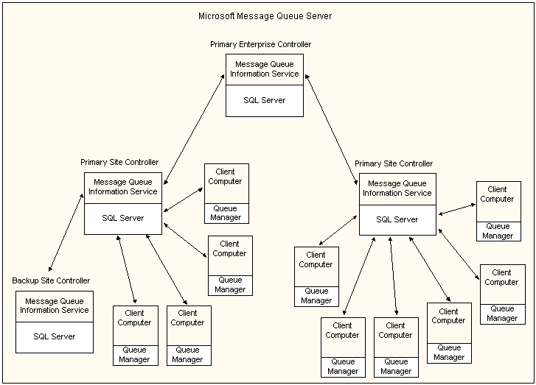
Message Queue Architecture:
Decoupling Services with a Message Broker
Message queue architecture involves using a message broker, such as RabbitMQ or Apache Kafka, to decouple services. Services communicate by passing messages through the message broker.
Message Queue Architecture: Message queue architecture involves using a message broker to decouple services. Services communicate by passing messages through the message broker.
Node.js Library: The amqplib library is a popular library for interacting with RabbitMQ in Node.js.
Java Library: The Spring AMQP framework provides built-in support for RabbitMQ in Java.
Example use: An e-commerce application may use message queue architecture to handle order processing, where each step in the order process is a separate service that communicates through a message broker.

Slide 68
Data Management in Web Services

Slide 69
Data Quality: Ensuring Accuracy and
Reliability of Third-Party Data
Data quality refers to the accuracy, completeness, consistency, and reliability of data. In the context of third-party data, it is important to ensure that the data is of high quality and meets the needs of the application.
Data Quality: Data quality refers to the accuracy, completeness, consistency, and reliability of data.
Importance of Data Quality: Poor data quality can lead to incorrect decisions and inaccurate insights.
Techniques for Ensuring Data Quality: Data validation, data cleansing, and data profiling are techniques for ensuring data quality.
Example Use: A financial services application that relies on third-party market data must ensure that the data is accurate and up-to-date to make informed investment decisions.

Slide 70
Pulling Data When Needed:
Efficient Use of Third-Party Data
Pulling data from third-party sources when needed is an efficient way to use third-party data without incurring unnecessary overhead.
Pulling Data When Needed: Pulling data from third-party sources when needed is an efficient way to use third-party data.
Advantages of Pulling Data: Reduced overhead, increased flexibility, and better control over data usage.
Techniques for Pulling Data: REST APIs, web scraping, and data feeds are techniques for pulling data from third-party sources.
Example Use: A weather application that pulls weather data from a third-party source only when a user requests a weather report.

Slide 71
Caching Data: Improving Performance and Reducing Overhead
Caching data is a technique for storing frequently accessed data in a local cache to improve performance and reduce overhead.
Caching Data: Caching data is a technique for storing frequently accessed data in a local cache.
Advantages of Caching Data: Improved performance, reduced overhead, and improved availability of data.
Techniques for Caching Data: In-memory caching, file-based caching, and distributed caching are techniques for caching data.
Example Use: A news application that caches news articles for a certain period of time to reduce the number of requests to the third-party news API.

Slide 72
Logging Data: Tracking and
Analyzing Third-Party Data Usage
Logging data is a technique for tracking and analyzing the usage of third-party data, including usage statistics and usage patterns.
Logging Data: Logging data is a technique for tracking and analyzing the usage of third-party data.
Advantages of Logging Data: Improved visibility into data usage, better understanding of data consumption patterns, and improved optimization of data usage.
Techniques for Logging Data: Log files, analytics platforms, and reporting tools are techniques for logging data.
Example Use: A social media analytics application that logs user activity data to better understand user engagement and to optimize ad targeting.

Slide 73
Data Strategies

Slide 74
Relational Databases: When to Use Them
Relational databases are a traditional approach to managing structured data, and are useful when data needs to be organized and queried in a specific way.
Relational Databases: Relational databases are a traditional approach to managing structured data.
Advantages of Relational Databases: Well-defined data structure, efficient queries, and support for ACID transactions.
Use Cases for Relational Databases: Applications that require strict data consistency, such as financial applications and e-commerce platforms.
Example Use: A customer relationship management (CRM) system that stores customer data in a relational database for easy querying and analysis.

Slide 75
What is a Data Lake?
A Flexible Approach to Data Management
A data lake is a large, centralized repository for storing all types of data, including structured, semi-structured, and unstructured data. Unlike a relational database, a data lake is schema-less and does not require a predefined data structure.
Data Lake: A data lake is a large, centralized repository for storing all types of data, including structured, semi-structured, and unstructured data.
Schema-less: A data lake is schema-less and does not require a predefined data structure.
Flexibility: Data lakes offer a flexible approach to data management, enabling organizations to store and process data of various types and sizes.
Big Data Processing: Data lakes are designed for big data processing, enabling organizations to analyze large volumes of data using distributed computing frameworks.
Example Use: A retail organization that collects data from various sources, such as social media, customer reviews, and sales data, can use a data lake to store and analyze this data in a flexible and scalable manner, without the need for predefined data structures.

Slide 76
Data Lakes: When to Use Them
Data lakes are a more flexible approach to managing data, and are useful when data is unstructured or has unknown use cases.
Data Lakes: Data lakes are a more flexible approach to managing data, and are useful when data is unstructured or has unknown use cases.
Advantages of Data Lakes: Flexible data storage, support for unstructured and semi-structured data, and support for big data processing.
Use Cases for Data Lakes: Applications that require processing and analysis of large volumes of data, such as data science and machine learning applications.
Example Use: A marketing analytics platform that stores various types of marketing data in a data lake for easy access and analysis.

Slide 77
Relational Databases vs. Data Lakes:
Which One to Use for Your Data
Relational databases and data lakes serve different purposes and have different strengths and weaknesses. Choosing the right approach depends on the nature of the data and the requirements of the application.
Relational Databases vs. Data Lakes: Relational databases and data lakes serve different purposes and have different strengths and weaknesses.
Relational Databases: Relational databases are useful for structured data that requires well-defined data structures and efficient queries.
Data Lakes: Data lakes are useful for unstructured data that requires flexible data storage and support for big data processing.
Choosing the Right Approach: Choosing the right approach depends on the nature of the data and the requirements of the application.
Example Use: A healthcare data management system that stores patient data in a relational database for easy querying and analysis, but also uses a data lake to store large volumes of unstructured data from medical devices and sensors.

Slide 78
Key Takeaways and Further Reading

Slide 79
Key Takeaways:
Building Robust and Scalable Web Services
Web services enable applications to communicate and share data across different systems and platforms.
Key web service technologies include REST, SOAP, and MQTT, which each have their own strengths and weaknesses.
The OSI model and TCP/IP model provide a framework for understanding how network communication works.
Data management is a critical component of web services, and includes techniques such as data quality, data caching, and data logging.
Relational databases and data lakes are two approaches to data management, each with their own advantages and use cases.
Successful web service development requires careful planning, robust testing, and ongoing maintenance and monitoring.

Slide 80
Further Reading:
Explore Web Services and Data Management
RESTful Web Services by Leonard Richardson and Sam Ruby
Building Microservices by Sam Newman
Data Architecture: A Primer for the Data Scientist by W.H. Inmon
Big Data by Nathan Marz and James Warren
NoSQL Distilled: A Brief Guide to the Emerging World of Polyglot Persistence by Martin Fowler
Stream Processing with Apache Flink by Fabian Hueske and Vasia Kalavri

